Slide 1
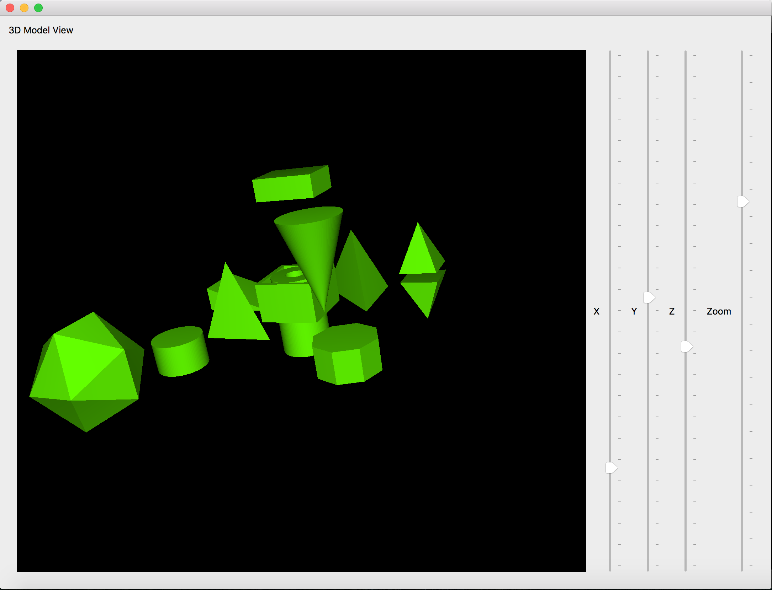
3D model using Analytical Shape
Team Members
Gregory Byrne
Shaotu Jia

Slide 2
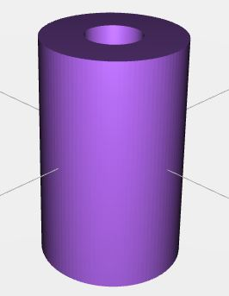
Overview
Purpose of our Project
Basic 3D Modeling with Facets
Structure of STL files
Project Architecture
Code Overview
Demo

Slide 3
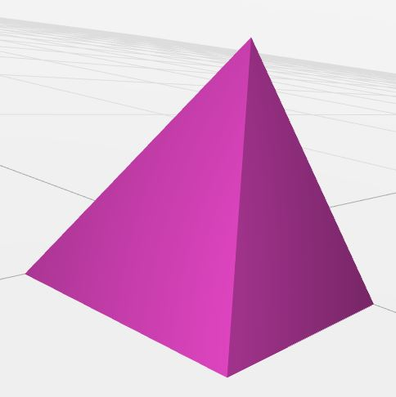
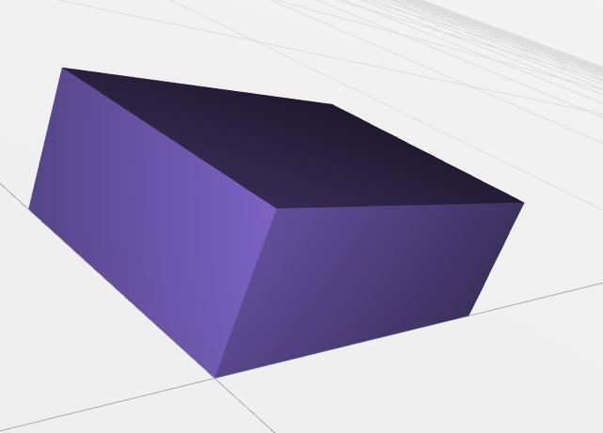
Purpose of our Project
Using QT’s OpenGL to generate and view 3D Models
Generate a Library of configurable shape objects
View generated 3D model
Output the Model data to an STL file

Slide 4
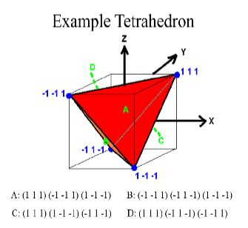
Basic 3D Modeling with Facets
Represent 3D objects by defining a series of triangles or facets
Triangles are defined in 3D space with Normal
Utilization of the right hand rule
Triangle data can then be output to a STL file

Slide 5
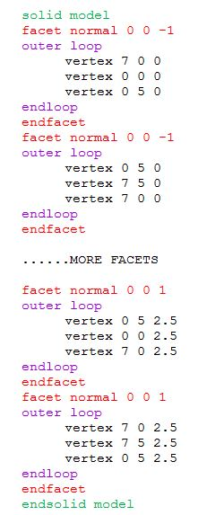
Structure of STL files
STL format: An STL “StereoLithography” file is a triangular representation of a 3 dimensional surface geometry
The surface broken down logically into a series of small triangles (facets).
Each facet is described by a perpendicular direction and three points representing the vertices (corners) of the triangle.

Slide 6
Project Architecture
Shape Library Generation
Model and STL
Render and Display
X , Y, Z
Shapes 3D Object
Shape Data
Model Data
Draw3D
Object
GLWidget
Object
tri
add
face
print3D
STL Writer
X, Y, Z
Rotation
View Distance
Cylinder Object
draw
Rectangle Object
Vertex Array Object
Window Design
Window
Buffer
Shader Program
Sphere Object
Triangle Object
Pyramid Object
Main Window
IconoSphere Object
Tetrahedron Object
X, Y, Z
Sliders
GL Widget
View Distance
Slider

Slide 7
Project Architecture
Create Shapes
Shape Data
Model Data
Draw3D
Object
print3D
STL Writer
GLWidget
Object
STL File
Visual 3D Model Viewer
Output STL File
Window
Vertex Array Object
Main Window
Buffer
X, Y, Z
Sliders
View Distance
Slider
Shader Program

Slide 9
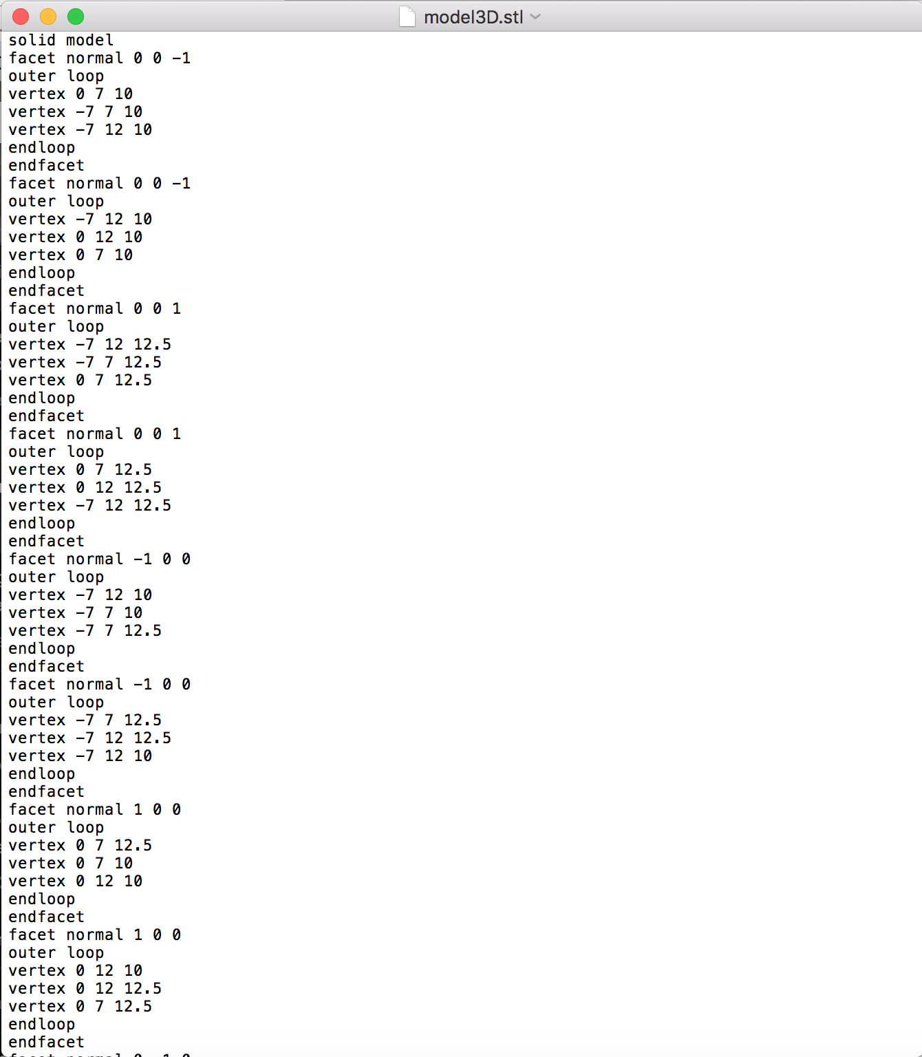

Slide 10
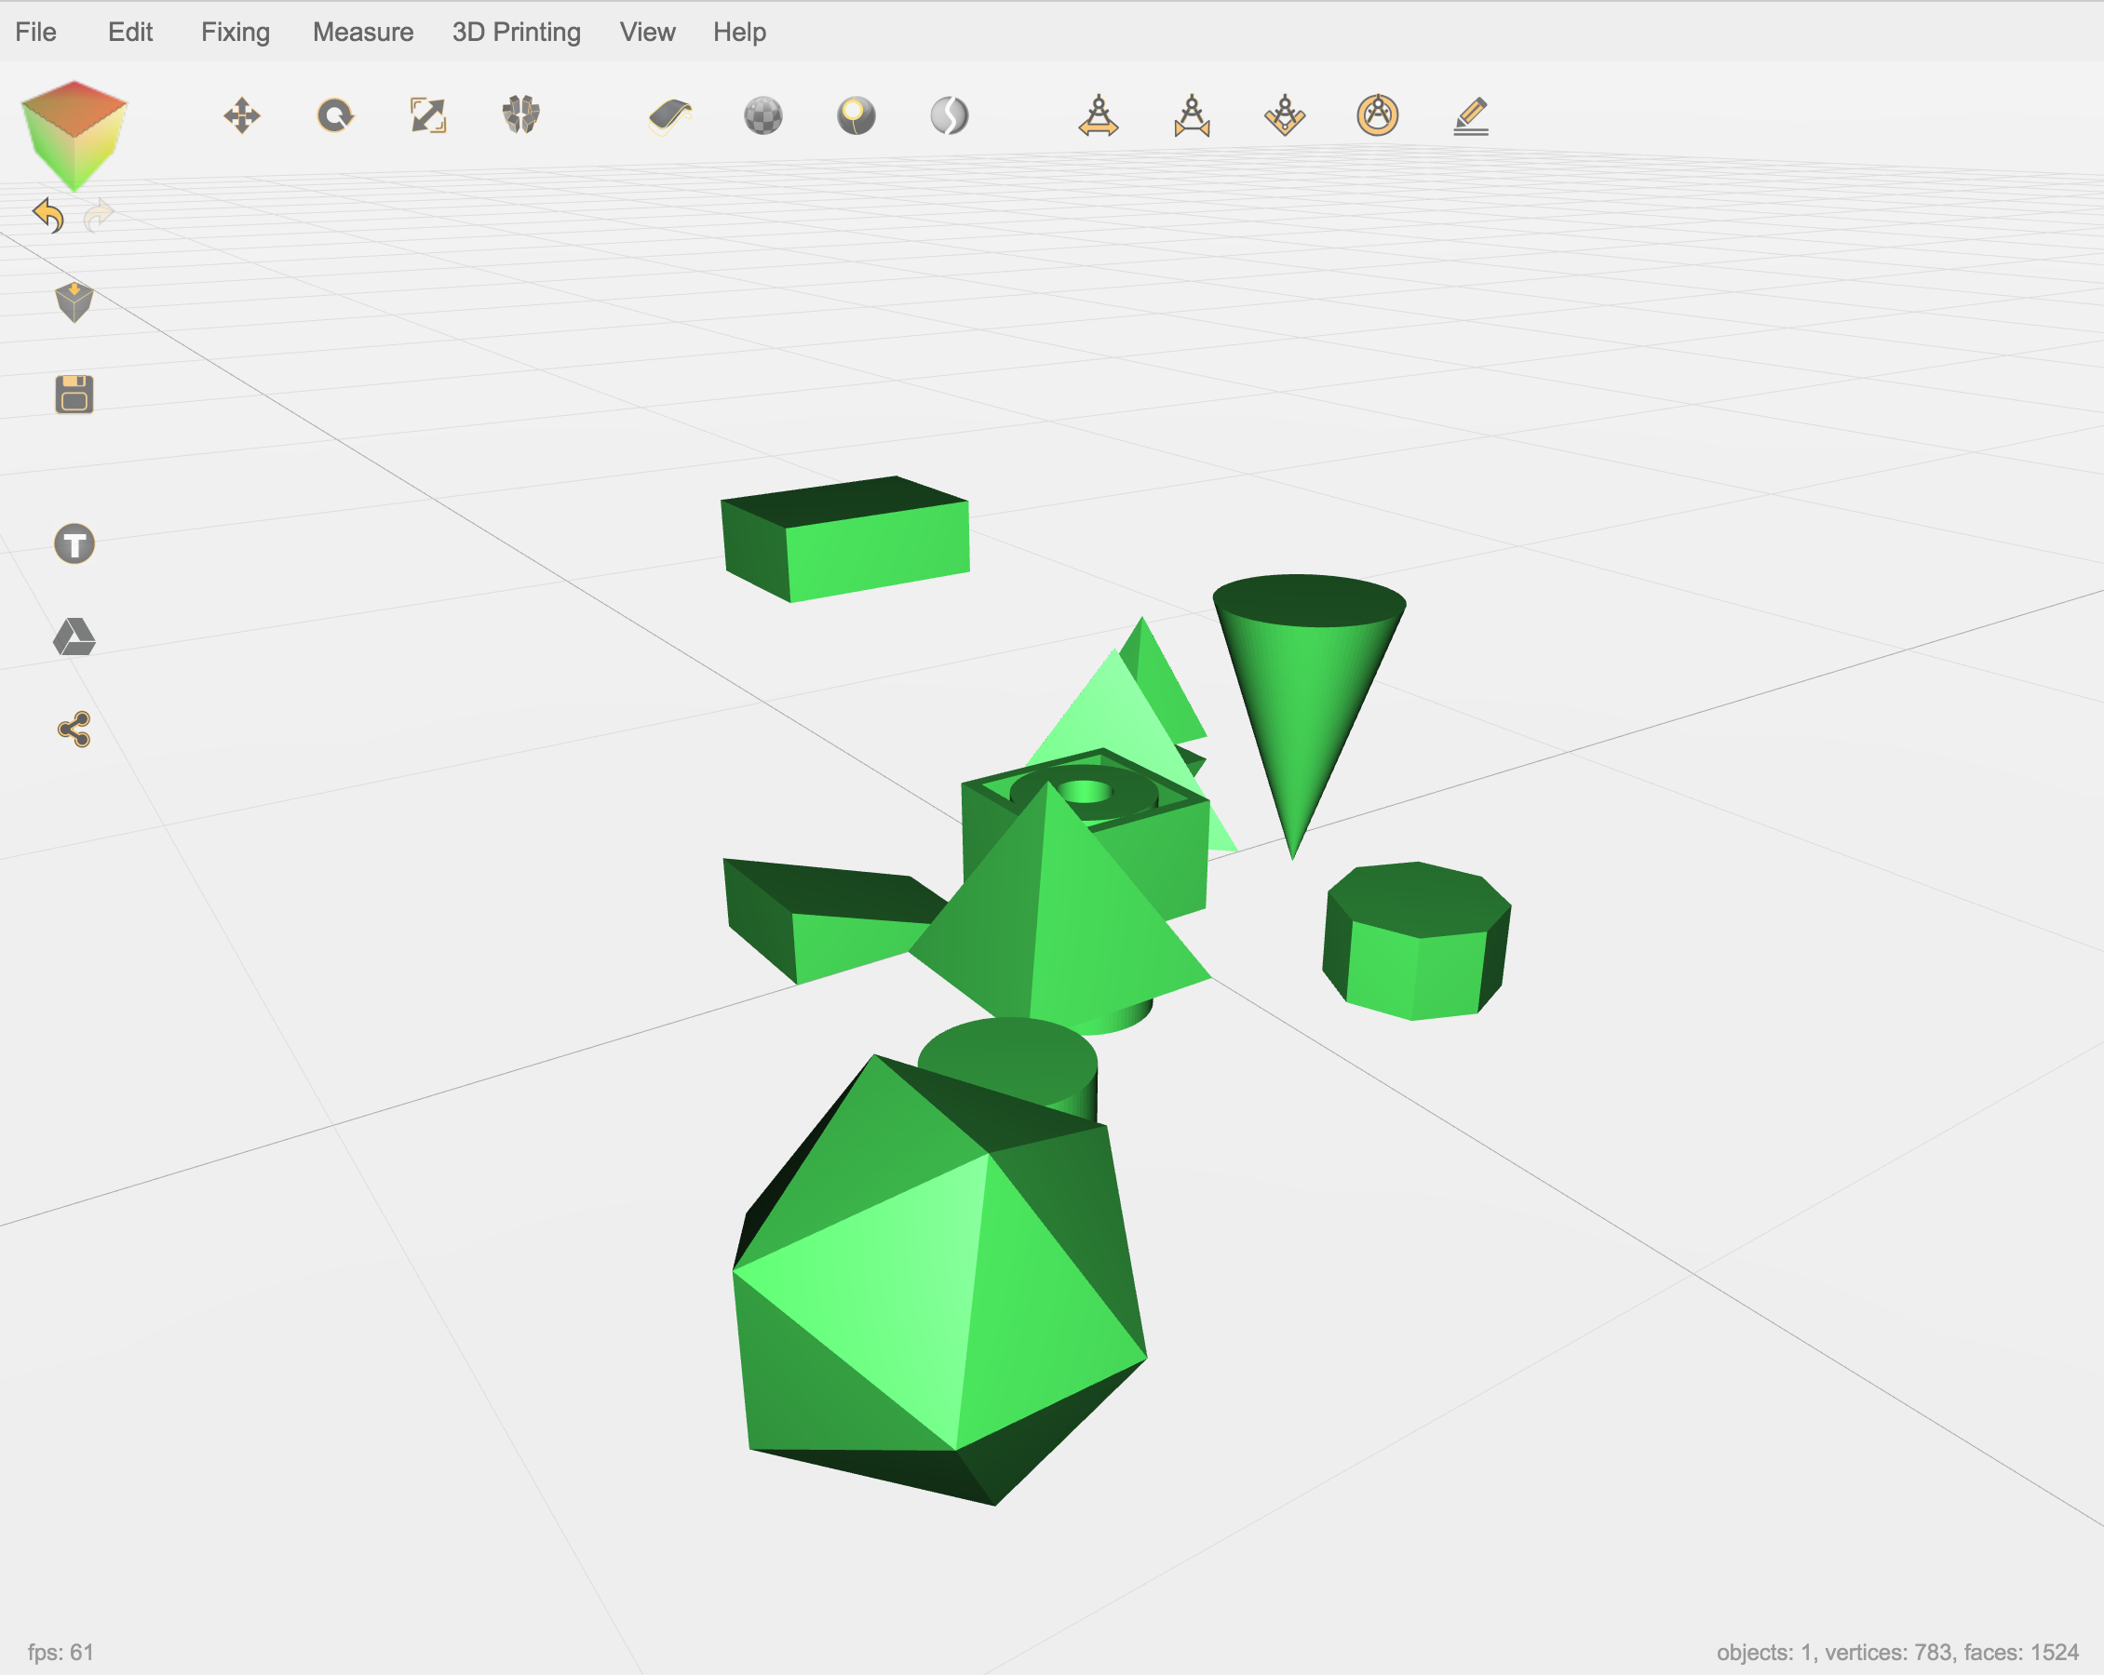

Slide 11
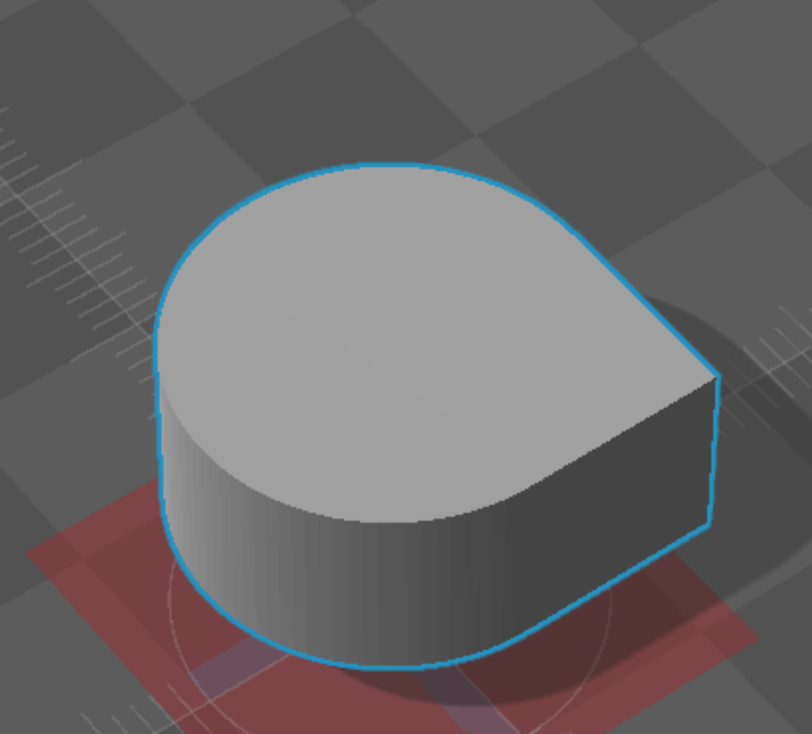
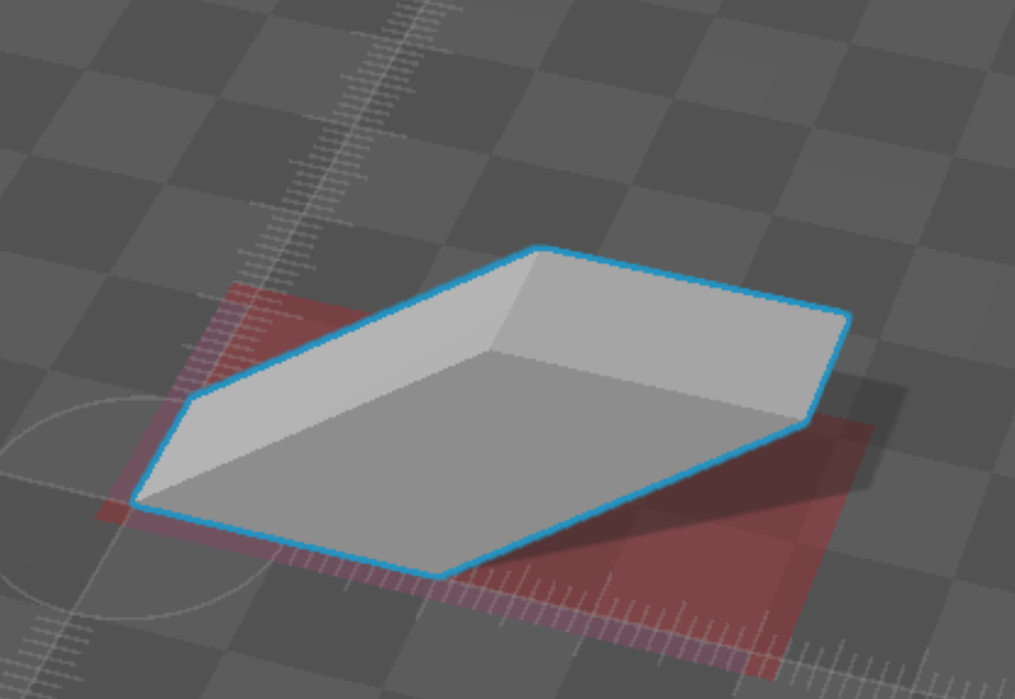
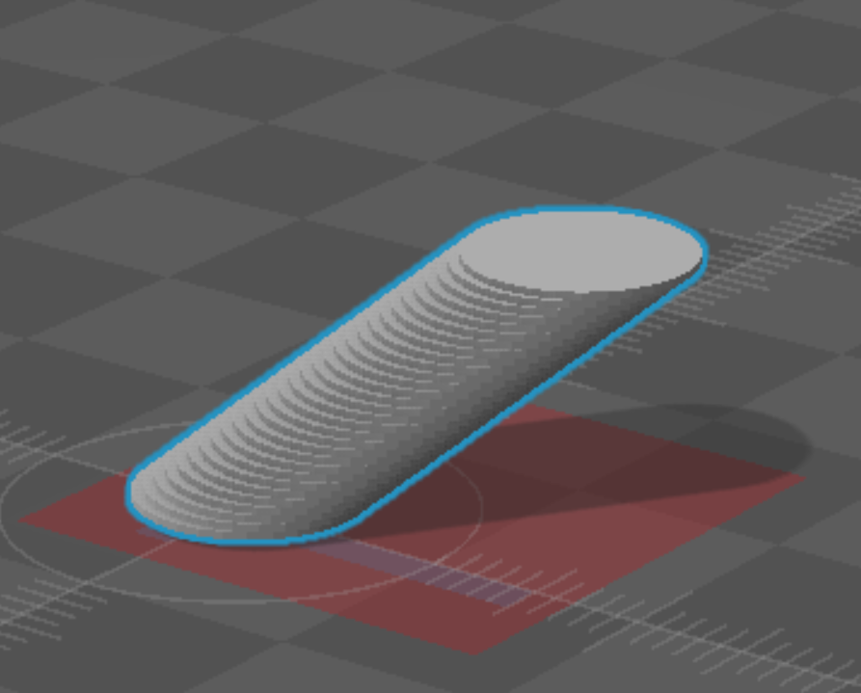
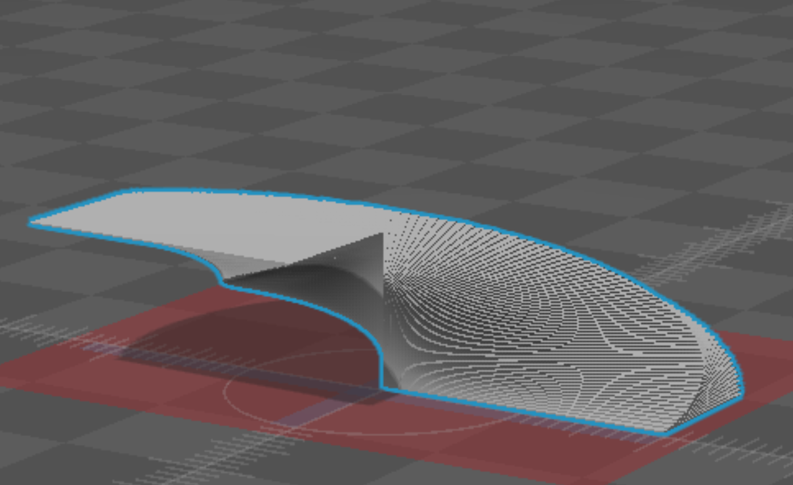
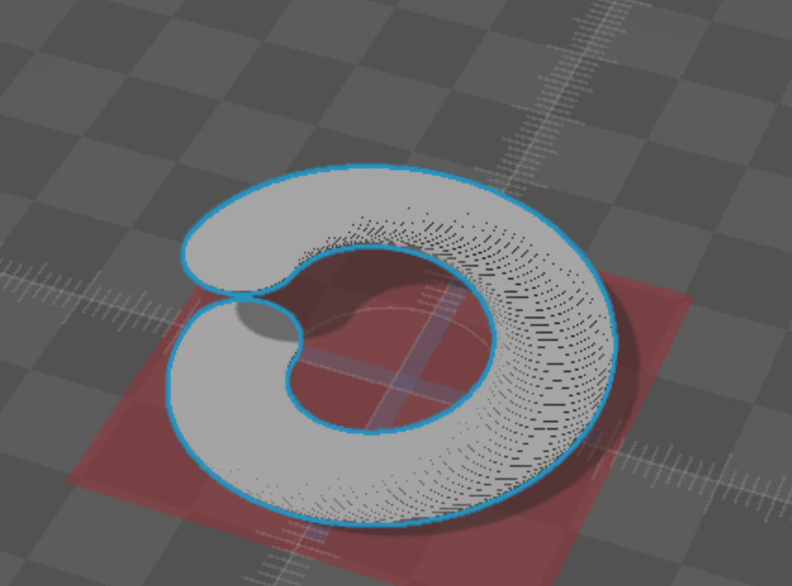
Union of Cylinder and Rectangle
Inclined Rectangle
Inclined Cylinder
Rotated Rectangle
Rotated Cylinder

